Slide 1

Shore Champion PPG Focus Group Meeting
Wednesday 14th January 2026

Slide 2
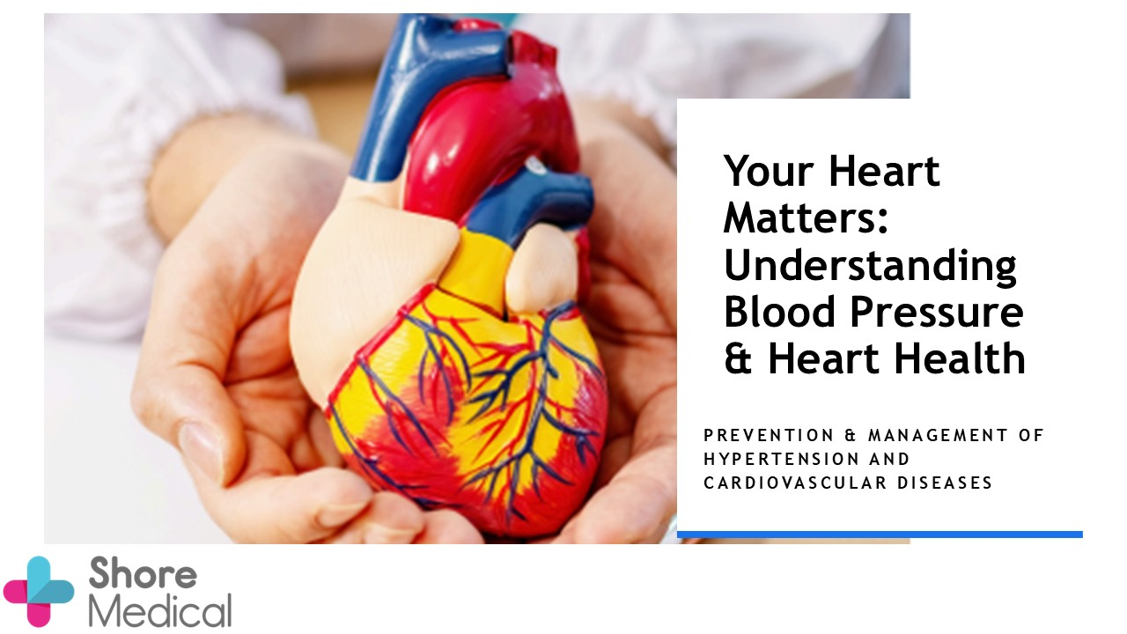
Hypertension Education Online event 2025
Hypertension Webinar 2025 – Another Great Success!
Following feedback from our face-to-face Hypertension Awareness Event in September, we hosted an online webinar to make the session more accessible and reach even more patients.
56 patients joined the webinar.
19 participants submitted blood pressure readings, making them eligible for our raffle.
5 lucky winners were drawn, and each received a £20 digital gift
Feedback was overwhelmingly positive:
91% of respondents found the discussion helpful, particularly the insights shared by Dr. Smith on hypertension and cardiovascular health.
Attendees also appreciated the information presented by Esther from Help & Care, who highlighted local services available to support wellbeing.

Slide 3

Patients told us:
“Many thanks for a very informative session 😄”
“Just great to know what services are available and how and why you are taking this so seriously. Cheers.”
“the information given was very helpful and well visualised. It was much easier for me online rather than attending in person. Thank you very much.”
“Knowing that I can send in readings and have signed up to Viso app - also knowing I can seek support from help and care”
a very good way of presenting the subject. You get so much more when hearing Dr Smith speak about it, than reading online. Interesting to hear about the Shore Register, and I will follow up on the Omron Viso app.”
This was another successful event thanks to the dedication of our staff and the engagement of our patients.
Your Heart Health Matters - Shore Medical

Slide 4
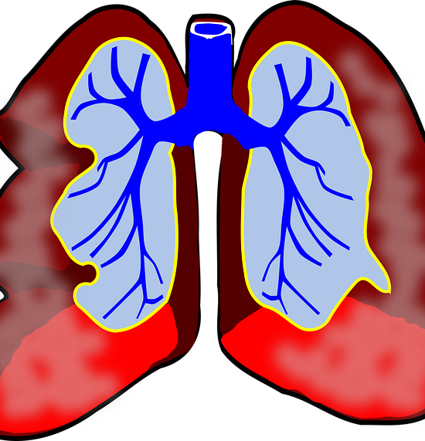
Respiratory Diagnostic Hub at St Mary’s
Respiratory Hub Clinics run every Monday and Thursday where Spirometry and FeNO (Fractional Exhaled Nitric Oxide) testing takes place to diagnose Asthma and COPD.
Referral to the clinic is made by our GPs/clinicians.
The service is run solely by Shore Medical Staff for its registered patients.

Slide 5


Pharmacy First
We continue to work closely to refer suitable patients to be seen initially by local Community Pharmacies.
We typically make between 400 and 600 referrals a month/
The Community Pharmacies have our direct number and can refer back urgently, any case they think we need to see, but this is typically only a few per 100.
Following that, up to 5 patients per 100 need a routine GP/ANP follow up appointment
so
about 90-95 appointments are saved for every 100 referred
which has greatly increased our capacity to deal with those patients who have greater needs, such as younger children, the elderly/frail, complex patients or those with mental health or learning disabilities.

Slide 6
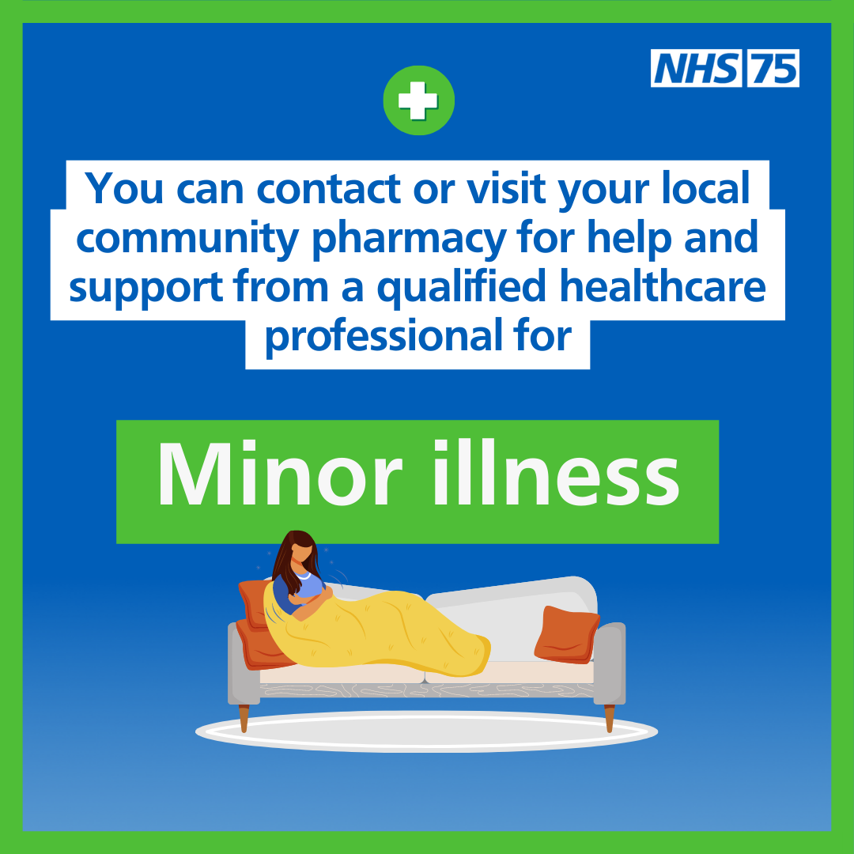
Community Pharmacist Training
Community Pharmacies are trained and funded to see patients over the age of 1 with a wide variety of conditions. Common conditions include:
colds
coughs
sore eyes
hay fever
pain
skin issues
They can also dispense medication such as antibiotics, if needed, for 7 common conditions:
The following table shows the 7 conditions pharmacists can manage across various age ranges.

Slide 7
Seven Conditions pharmacists can manage across various age ranges
Clinical pathway | Age range
Acute otitis media* | 1 to 17 years
Impetigo | 1 year and over
Infected insect bites | 1 year and over
Shingles | 18 years and over
Sinusitis | 12 years and over
Sore throat | 5 years and over
Uncomplicated urinary tract infections | Women 16-64 years
Notes:
The public perceptions of community pharmacy survey found that over 90% of patients who sought guidance from a community pharmacy within the past year reported receiving good advice.

Slide 8

The publics perception of community pharmacy survey found that over 90% of patients who sought guidance from a community pharmacy within the past year reported receiving good advice.
This Photo by Unknown Author is licensed under CC BY-NC

Slide 9
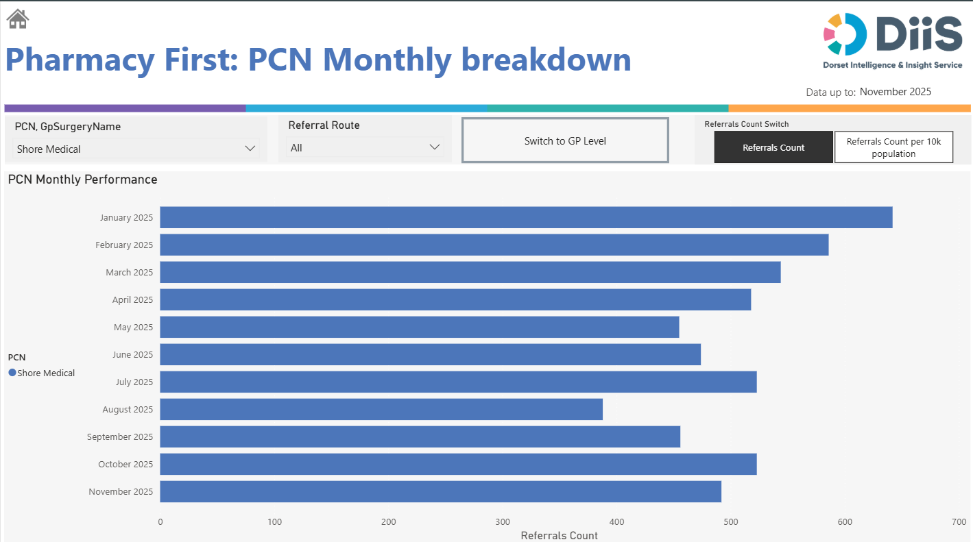

Slide 10
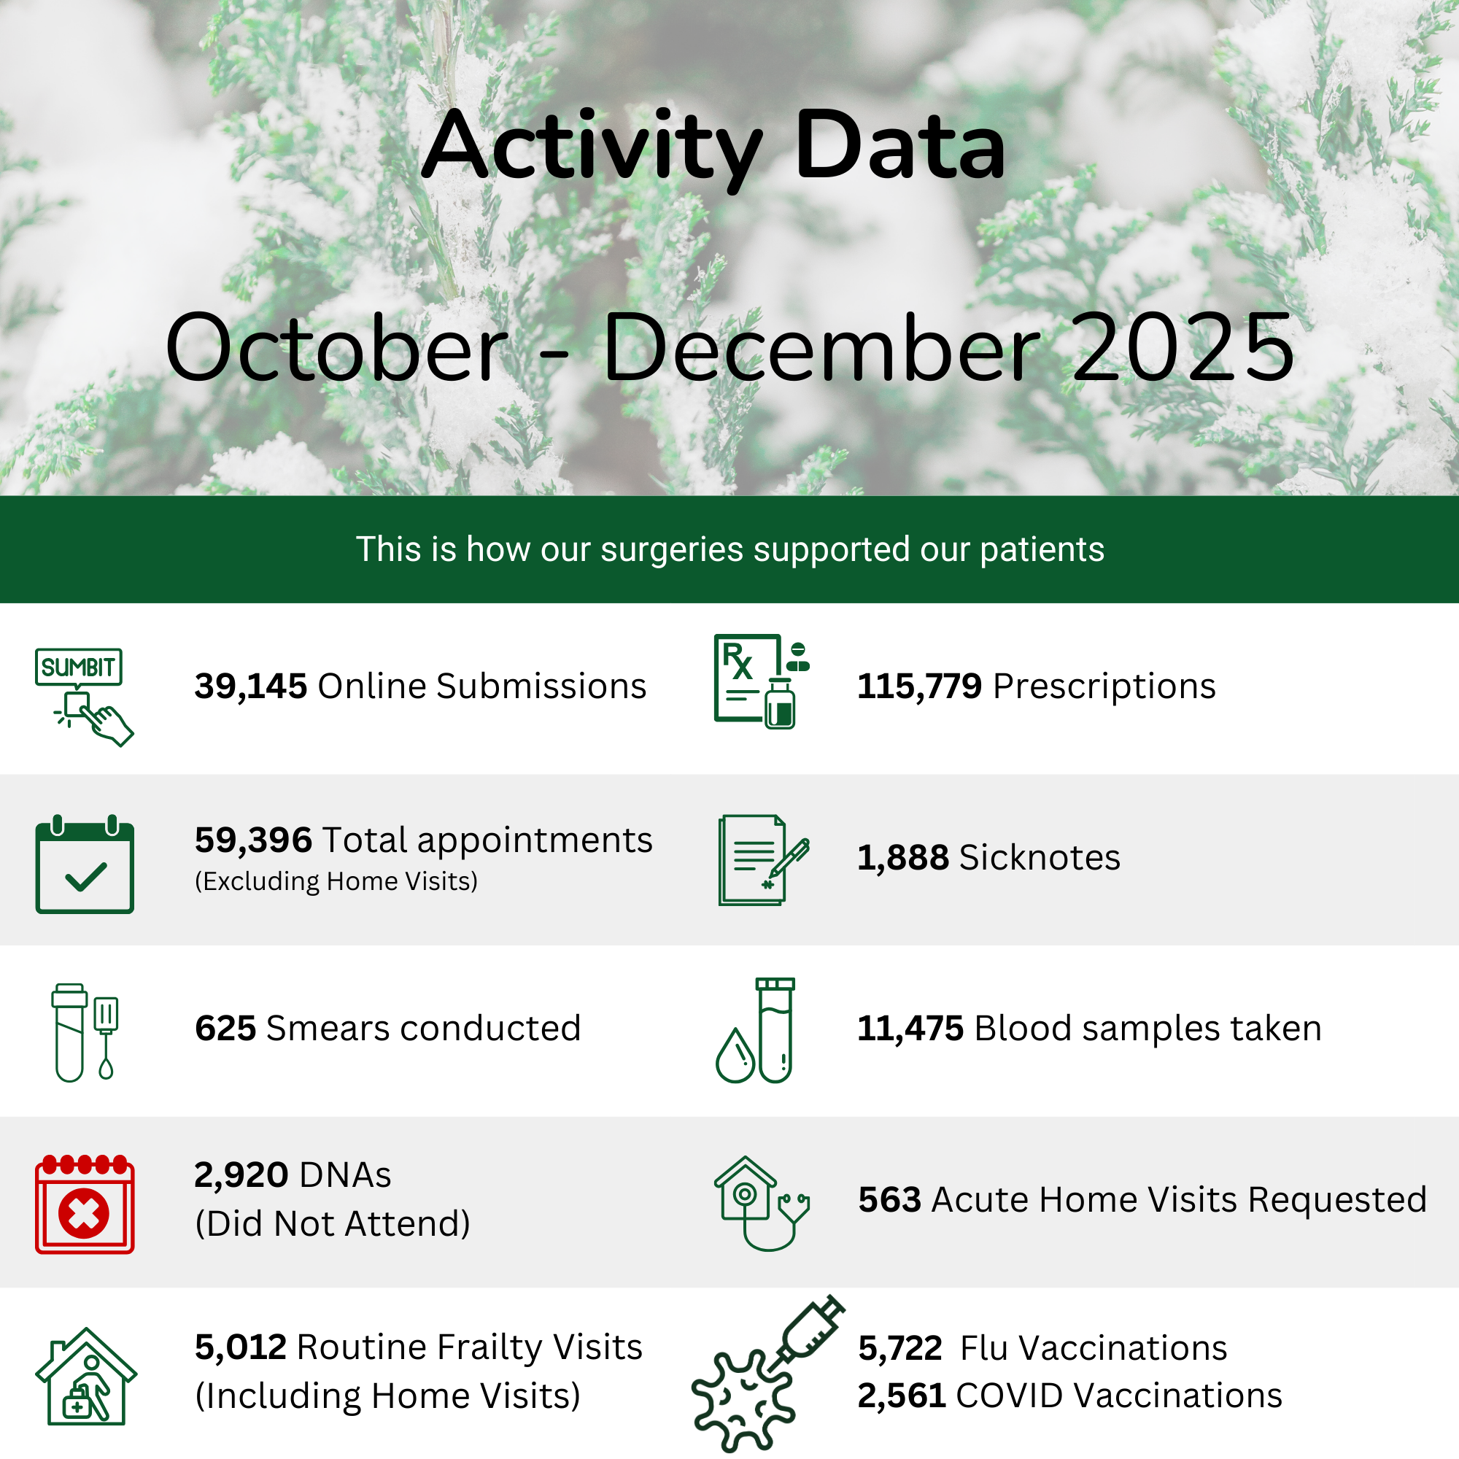

Slide 11

Urgent Medication
We have an urgent medication policy which includes those medications which are clinically urgent.
Urgent Medications
Antibiotics if already prescribed and unavailable
Salbutamol or equivalent reliever inhaler
GTN spray
Medication to treat abnormal heart rhythm
Oral nitrates/Nicorandil
Insulin
Adrenalin Pen (EpiPen)
Oral steroids
Palliative care patient medications
Anticoagulants including DOACs and Warfarin
Parkinson’s disease medications
• Anti-epileptics (when used for epilepsy)

Slide 12
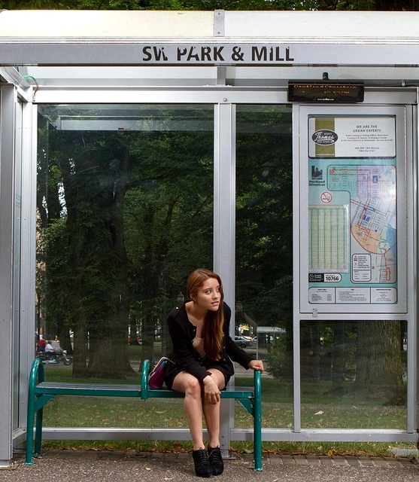
Urgent Request for Medication on the Urgent List
We will try to deal with all requests for medications listed on the urgent list on the same working day where clinical capacity allows.
Please plan your medication requests in advance as urgent requests put extra strain on the service.
If the item requested is not on this list, then the patient must wait to 2-3 working days for their prescription.

Slide 13
Information on How to Request Repeat Prescriptions
Prescriptions - Shore Medical

Slide 14
Care Navigation - Number of Connects received into triage between November 24 to December 2025
Month | Into Triage | SDA | ANP | 5day | Routines | PharmRefer | MSK | Advice | Pharmacy Team | CN clinician resolved | Patient Services | scripts | med | sec
November | 10000 | 2796 |  | 1101 | 1786 | 645 | 285 | 1001 | 92 | 1556 | 266 | 26 | 11 | 18
December | 9133 | 4790 |  | 627 | 1230 | 703 | 185 | 991 | 81 | 1426 | 126 | 43 | 13 | 17
January | 11369 | 3559 |  | 1146 | 1284 | 587 | 277 | 1310 | 98 | 1495 | 263 | 48 | 19 | 17
February | 9872 | 3068 |  | 823 | 1723 | 518 | 242 | 1219 | 76 | 1416 | 389 | 36 | 14 | 24
March | 10577 | 3054 | 109 | 1032 | 1760 | 483 | 240 | 1433 | 94 | 1544 | 422 | 446 | 127 | 17
April | 10485 | 2035 | 384 | 1044 | 1564 | 436 | 212 | 1304 | 173 | 1282 | 377 | 415 | 102 | 17
May | 10175 | 1886 | 891 | 997 | 1523 | 367 | 250 | 1383 | 164 | 1286 | 402 | 409 | 131 | 26
June | 10139 | 2166 | 1001 | 1063 | 1449 | 393 | 235 | 1408 | 193 | 1306 | 392 | 1403 | 137 | 18
July | 11415 | 2510 | 875 | 1253 | 1685 | 385 | 288 | 1607 | 241 | 1431 | 481
August | 8905 | 1905 | 702 | 914 | 1442 | 302 | 234 | 1221 | 209 | 2185 | 427 | 1364 | 125 | 30
September | 11393 | 2538 | 1024 | 1308 | 1660 | 351 | 250 | 1967 | 167 | 1250 | 674 | 1590 | 196 | 27
October | 10679 | 2121 | 1048 | 1240 | 1610 | 463 | 258 | 1479 | 258 | 1397 | 461 | 1421 | 168 | 19
November | 9634 | 1945 | 950 | 1069 | 1387 | 417 | 265 | 1482 | 248 | 1261 | 381 | 1362 | 140 | 29
December | 9745 | 1944 | 1051 | 848 | 1185 | 511 | 196 | 1416 | 218 | 1445 | 415 | 1398 | 132 | 24
totals | 143521 | 36317 | 8035 | 14465 | 21288 | 6561 | 3417 | 19221 | 2312 | 20280 | 5602 | 9961 | 1315 | 283

Slide 15

In Summary
Connect Cases resolved within Care navigation (triage team) to date with advice
39501
These resolved cases free up appointments for those in more need.
This Photo by Unknown Author is licensed under CC BY-NC-ND

Slide 16

Thank you for listening
This Photo by Unknown Author is licensed under CC BY

