Slide 1

Shore Medical PPG Focus Group Meeting 16th July 2025
Shore Medical update

Slide 2
Introduction to New PCN Clinical Director -
Dr Simon Rees
Dr Rees would like to express his thanks to Dr Nick Evans for his hard work and dedication over the last 3 years.
Dr Rees is looking forward to taking this role on and is passionate about the amazing work we all do in Shore Medical, providing excellent care for our patients. He is really keen to explore any ways we can improve things.
His key objectives as Clinical Director would be:
Communication
Data-driven changes
Improving patient care
Workforce wellbeing and development

Slide 3
What is the role of a PCN Clinical Director?
The Clinical Directors role is to support the co-ordination of delivery of care across the partnership. They should provide clinical input for Shore’s strategic plans and work closely with the partnership and senior management team to improve the quality and effectiveness of the network services. The Clinical Director should be able to develop relationships with other network clinical directors/clinical leaders and represent Shore Medical at ICB level clinical meetings to ensure any internal considerations are highlighted and fall in line with wider NHS strategy.

Slide 4

The NHS 10 Year PLAN
The NHS Plan will focus on three radical shifts:
Hospital to Community
Analogue to Digital
Sickness to Prevention

Slide 5

Hospital to Community
Expansion of Neighborhood Health Centres and services in community settings by 2035. Designed around the patient to provide continuous accessible and integrated care into local communities.
Expect more diagnostics, mental health, dental and social care within primary care.

Slide 6

Integrated Neighbourhood Teams:
We are now working collaboratively with the local council, voluntary sector, Dorset HealthCare, and other community services to streamline and coordinate care through Integrated Neighbourhood Teams within primary care. This joint approach aims to improve support and pathways for our most vulnerable patients, with a particular focus on housebound, frail individuals and those experiencing mental health challenges. By bringing together a wide range of services, we hope to provide more efficient, person-centred care tailored to individual needs.

Slide 7
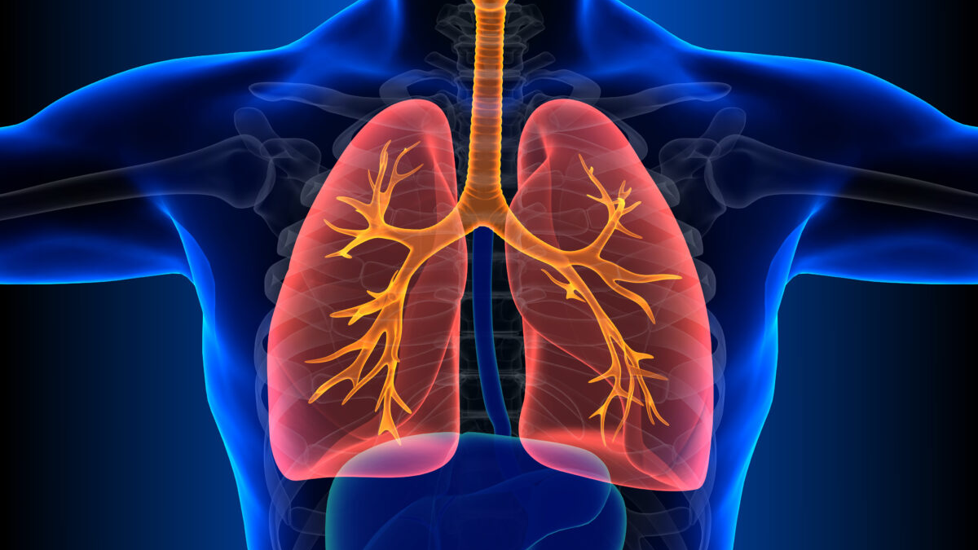
Respiratory Hub
We are launching a new Community Respiratory Hub based at St Mary’s Hospital in Poole to provide respiratory diagnostics closer to home for our patients.
This service aims to improve access and reduce waiting times by delivering high-quality respiratory assessments and diagnostics within a community setting, ensuring timely and convenient care for those with respiratory conditions.
We are hoping for this to start in August 2025.

Slide 8

Analogue to Digital - Power In Your Hands
Modern technology has given us more power over our everyday lives. But that same scale of change has yet to come to the NHS. Patients will have a ‘doctor in their pocket’ in the form of the NHS App, while staff will be liberated from a burden of bureaucracy and administration.
By harnessing the digital revolution, we will be able to:
ensure rapid access for those in generally good health
free up physical access for those with the most complex needs
help ensure the NHS’s financial sustainability for future generations
By 2028 there will be significant upgrades to the NHS APP, including self referrals, shared records and A1 support. All tools and digital systems to reduce admin burden and streamline workflows.

Slide 9

Sickness to prevention: Power To Make The Healthy Choice
Focus will be on early interventions targeting obesity, smoking , vaccines and public health nudges
Ambition is to halve the healthy life expectancy gap between richest and poorest areas

Slide 10

Shore Medical Objectives
To fulfil our contractual obligations – we have no influence over these
Our focus for this year and potentially next year will be on three areas:
Recruitment and Retention
Improving Inequalities in Health Care
Improving Digital Access uptake for patients

Slide 11
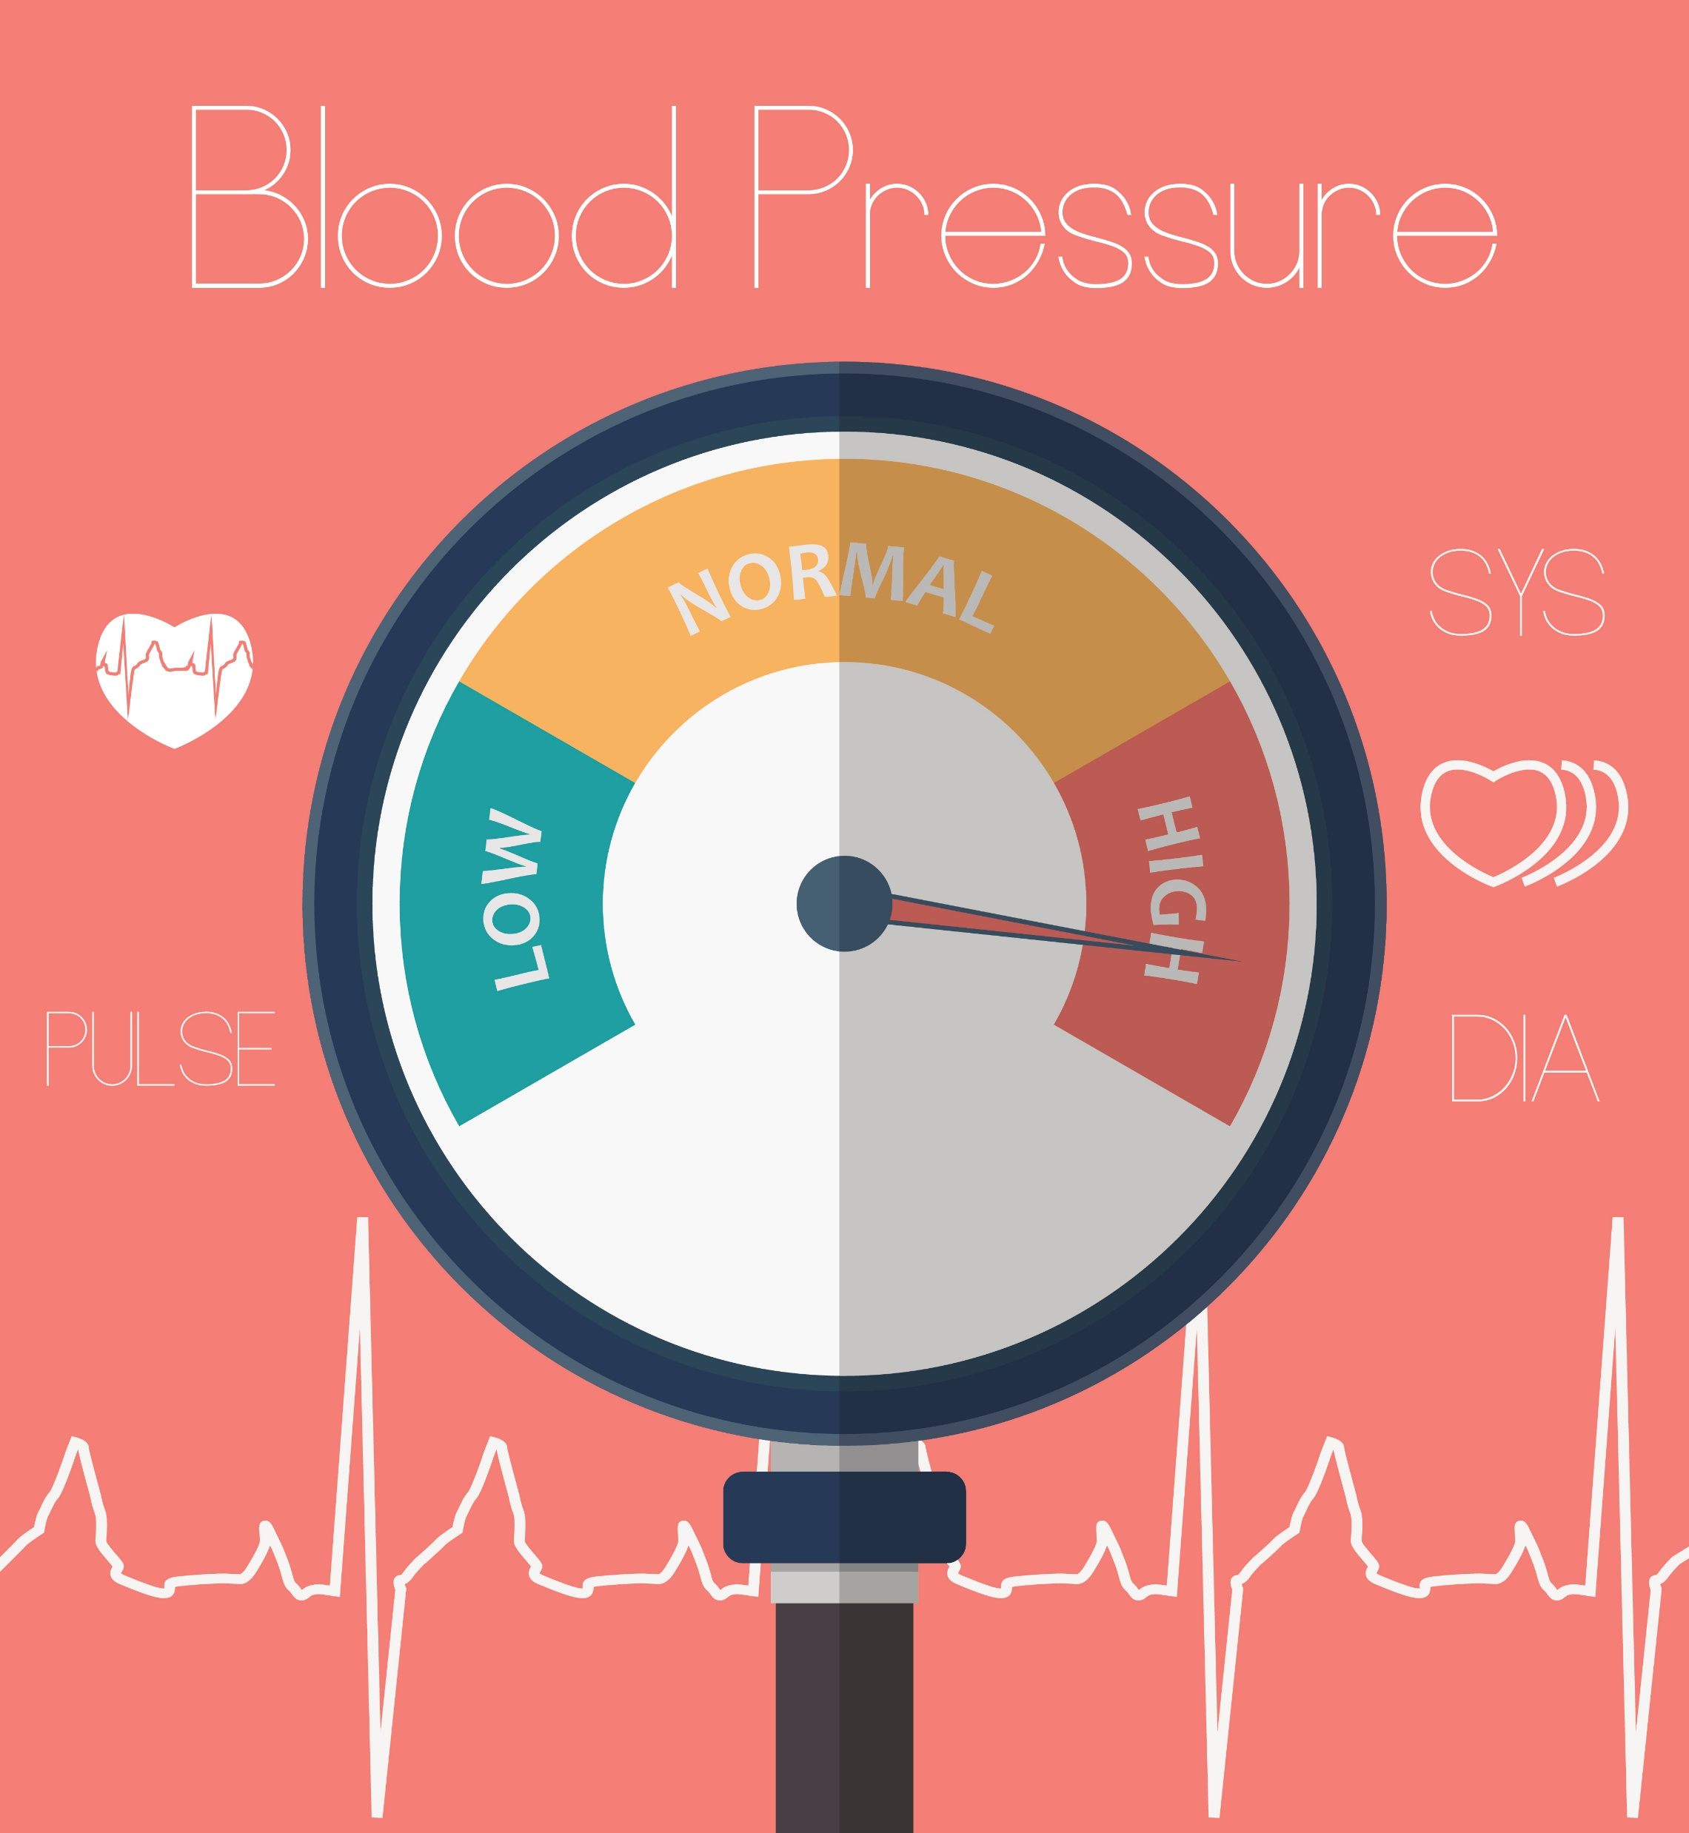
Hypertension event/Campaign
Hypertension is the highest rate of avoidable death.
Shore Medical is hosting an event targeting non -responders of uncontrolled hypertension (blood pressure)
Two specific groups are being targeted:
Ethnic minorities
Deprivation groups
Patients will be advised to bring home bp readings to the event., those that to will be entered be into a raffle (we are seeking ppg volunteers to help with raffle and generally, teas and Coffee etc)
There will be a Hypertension Education talk from a GP, digital support for the VISO app and the NHS app. There will also be Health Care Assistant led education on smoke-stop and NHS health checks
Venue – Talbot View Community Centre, 3 Alder Park, Poole, BH12 4AY
Provisional date to be confirmed is 20th September 20025 - 9am to 1:30pm - Two sessions will run within that timeframe – attendance will be pre-booked to the event.
Stands/stalls from - Park Run, Livewell Dorset, Active Dorset . PPG to do a stand to promote and encourage new members .

Slide 12
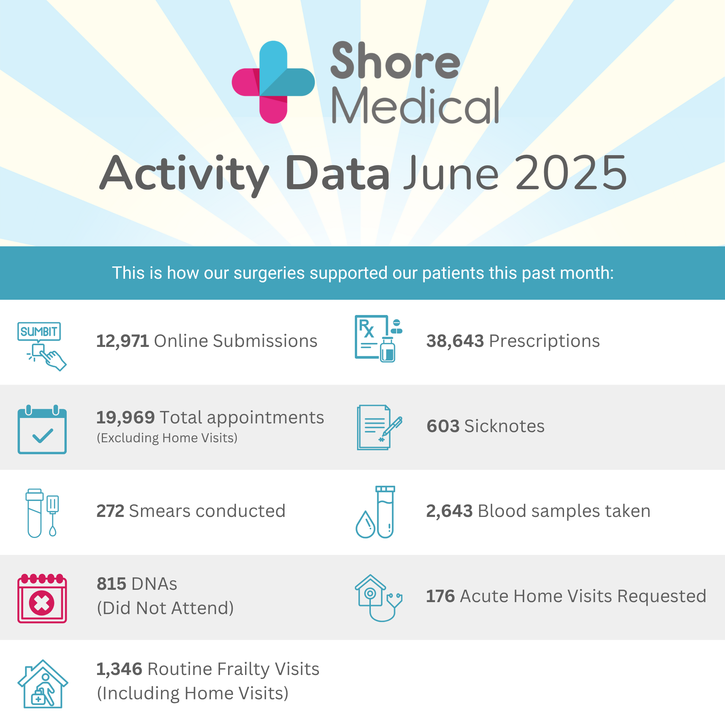
Statistics June 2025 data

Slide 13
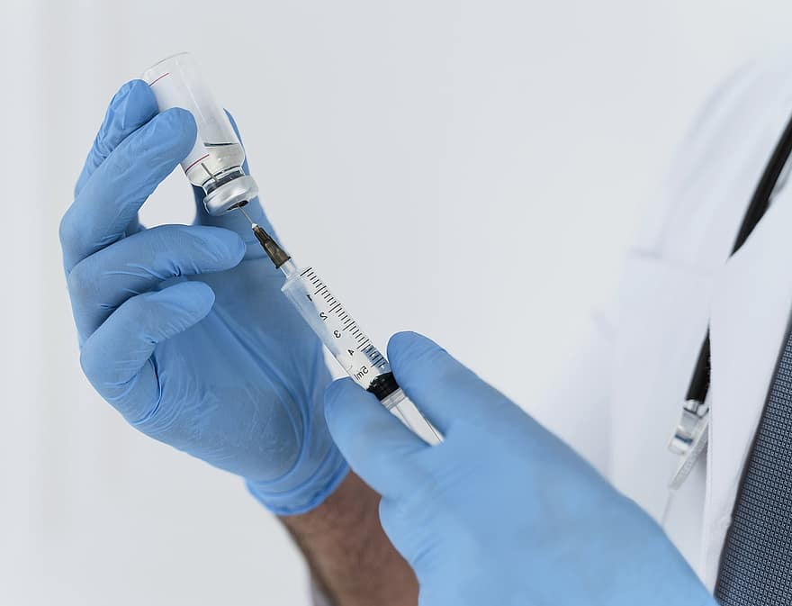
Covid Uptake Spring Boosters 2025
COVID Vaccinations

Slide 14
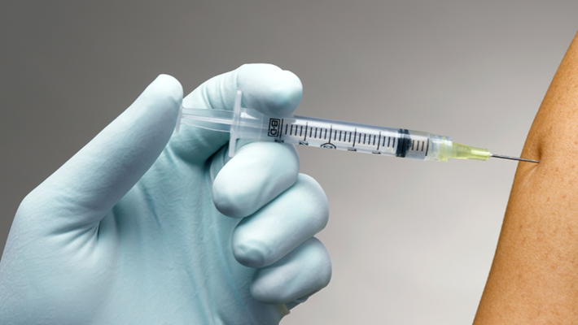
Autumn covid vaccine programme
Shore is participating in the Autumn Covid & flu programme again this year.
This will commence on the 6th October for Care Homes and Saturday 4th October for the main cohort
Covid Eligible cohorts are:
  75 years and over
  Residents in a care home
  Individuals aged 6 months and over who are immunosuppressed
Flu Eligible Cohorts
Patients will be informed by SMS text message, but they cannot book until the invite is received. The message will state that we are about to start the programme, please wait to receive your invitation link.
Invites will go out as soon as finalised reports are received from NHS England.
This Photo by Unknown Author is licensed under CC BY-NC-ND

Slide 15


