Slide 1

PPG Focus Group Meeting 8th October 2025
Shore Medical Update

Slide 2
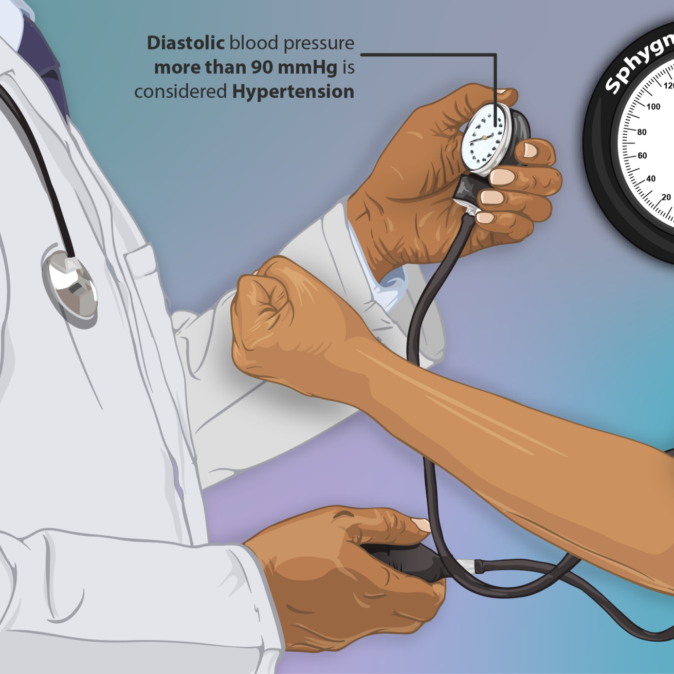
Hypertension Event Feedback
Sarah & Anne
The event held on the 20th September was a huge success and was received positively by patients
We also managed to promote the work of the PPG and have had 45 expressions of interest.
We are therefore hosting two events to be held at Fernside Surgery to promote the PPG and hopefully gain more members. Gill will present on what is a PPG and Sarah will talk of her experience as a PPG member for many years.
It would be helpful if you could attend one of these events to help with Teas and coffee and have a presence. Sue and Keith could speak about the coffee mornings and lunch club as an example of the work you do.
Advertising of roles – Chair person /Secretary /coordinator etc

Slide 3
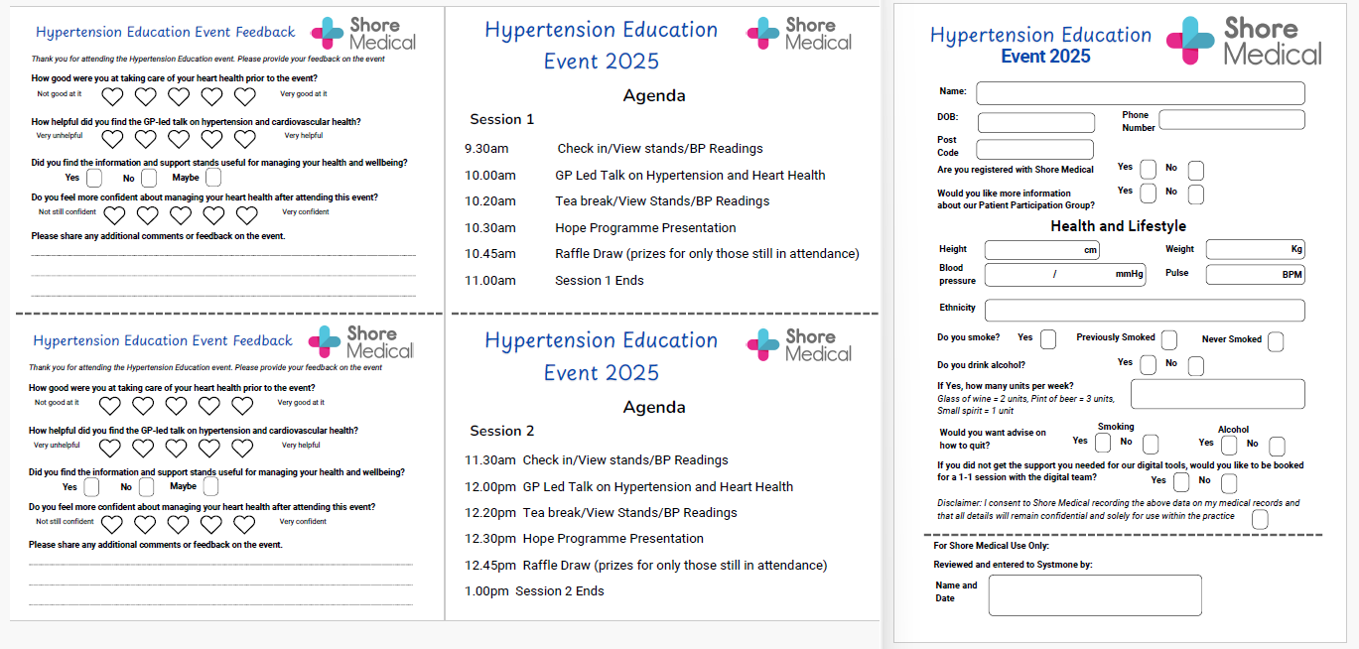
Event Day
PCN Staff:
GP, Reception, Business Manager,
Patient Liaison Manager, HCA, DT
Shore Champion PPG member
Stands:
Livewell Dorset,
Help&Care (Also H4C)
Raffle Items:
BP Monitors
Exercise/Yoga Mat
Cookery books
Sainsbury Vouchers

Slide 4
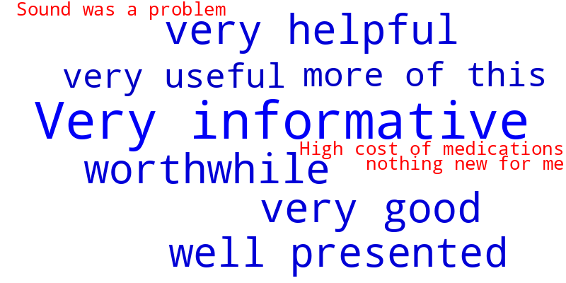
Event Feedback

Slide 5

New Patient Registration
Sarah M to feedback on being a test patient
Patient can now register via the NHS App or via the website, search:
Find a GP or
Register with a GP

Slide 6
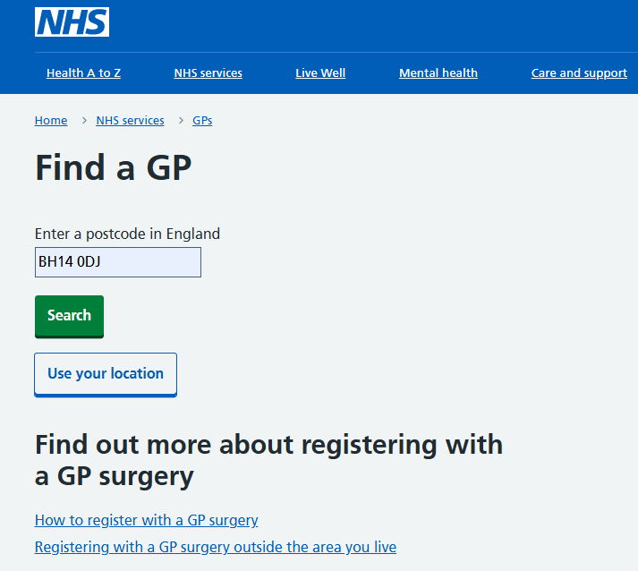
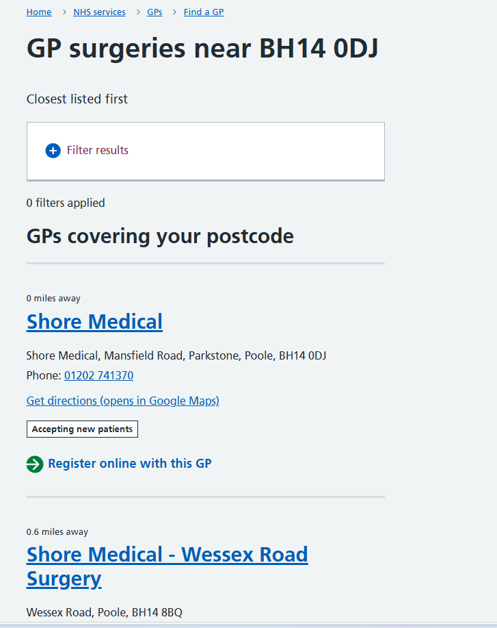
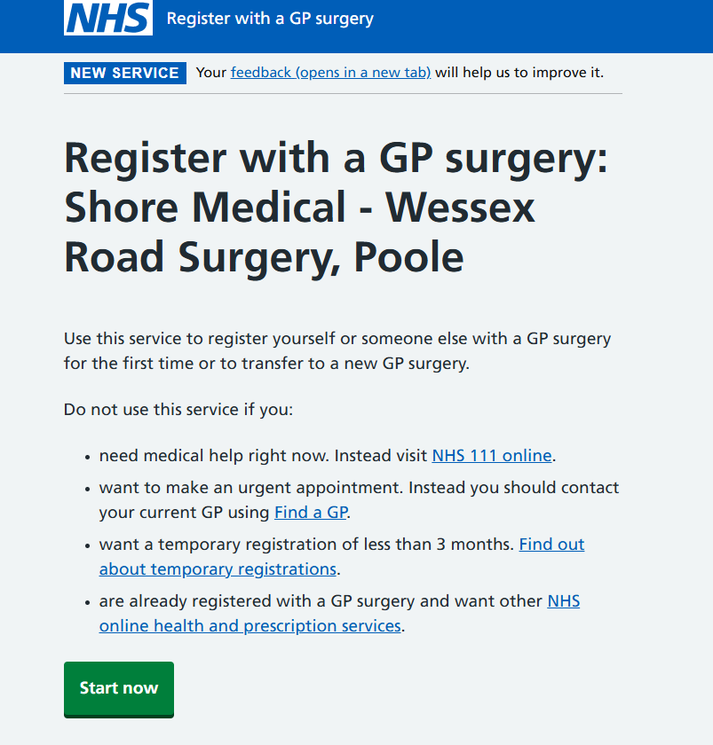
NHS E Find a GP service

Slide 7

Patient Information Display screens and Kiosks

Slide 8
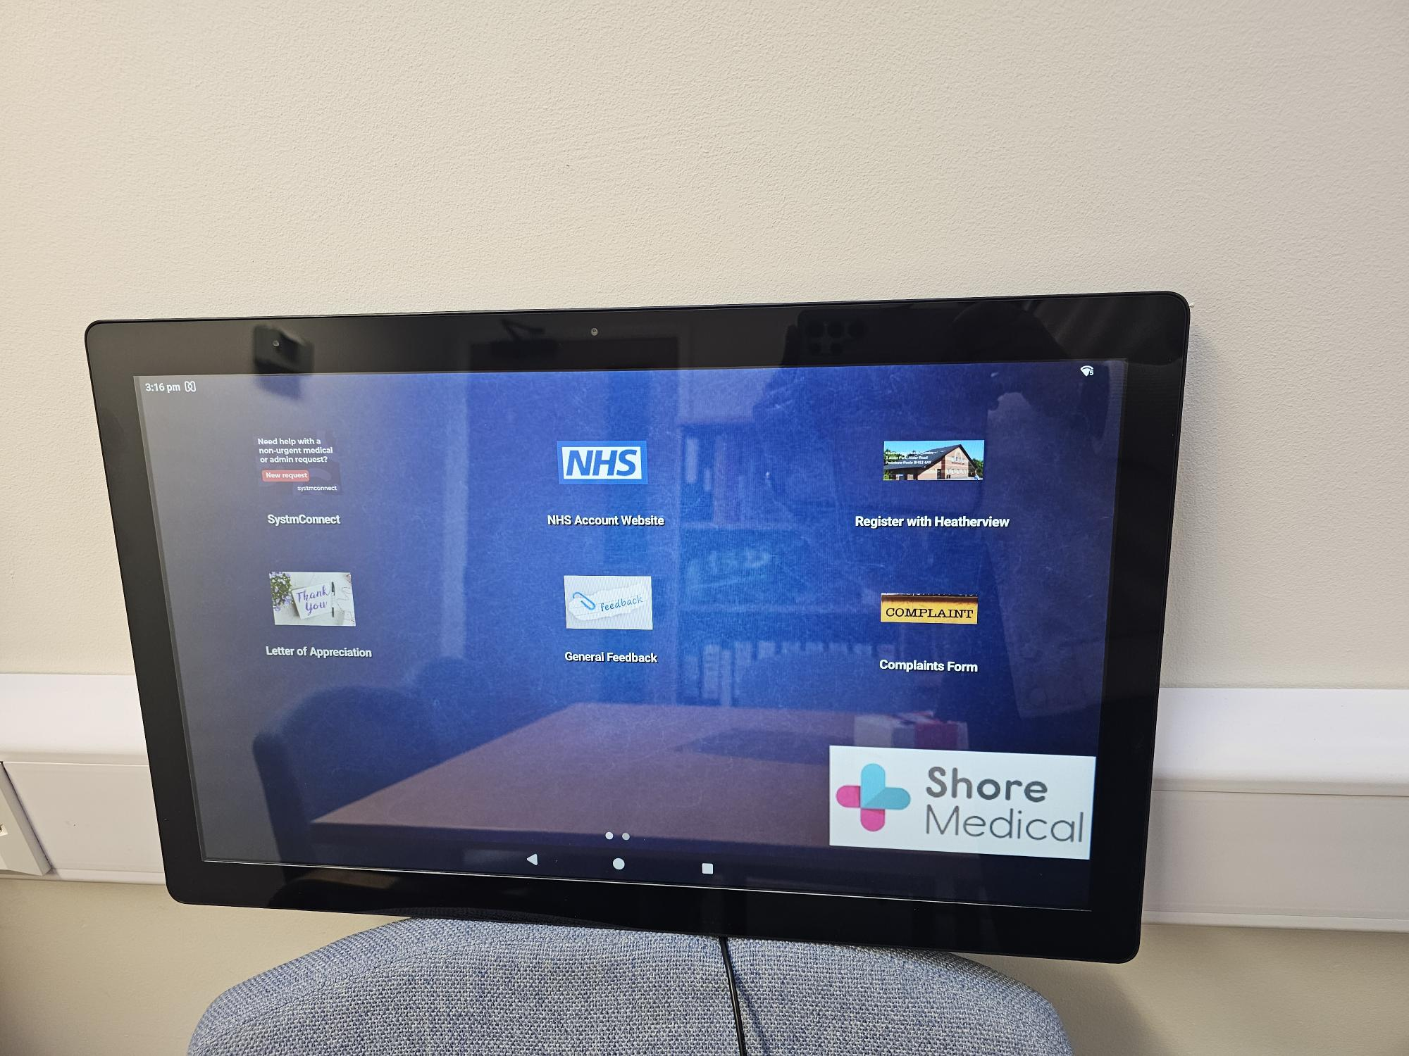
Patient Kiosk

Slide 9
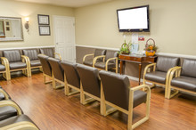
Patient Information Waiting Room Screens
Pilot at Heatherview as digital team based there
Roll out will follow at all sites once happy with the communications and software
All sites will support the same data

Slide 10
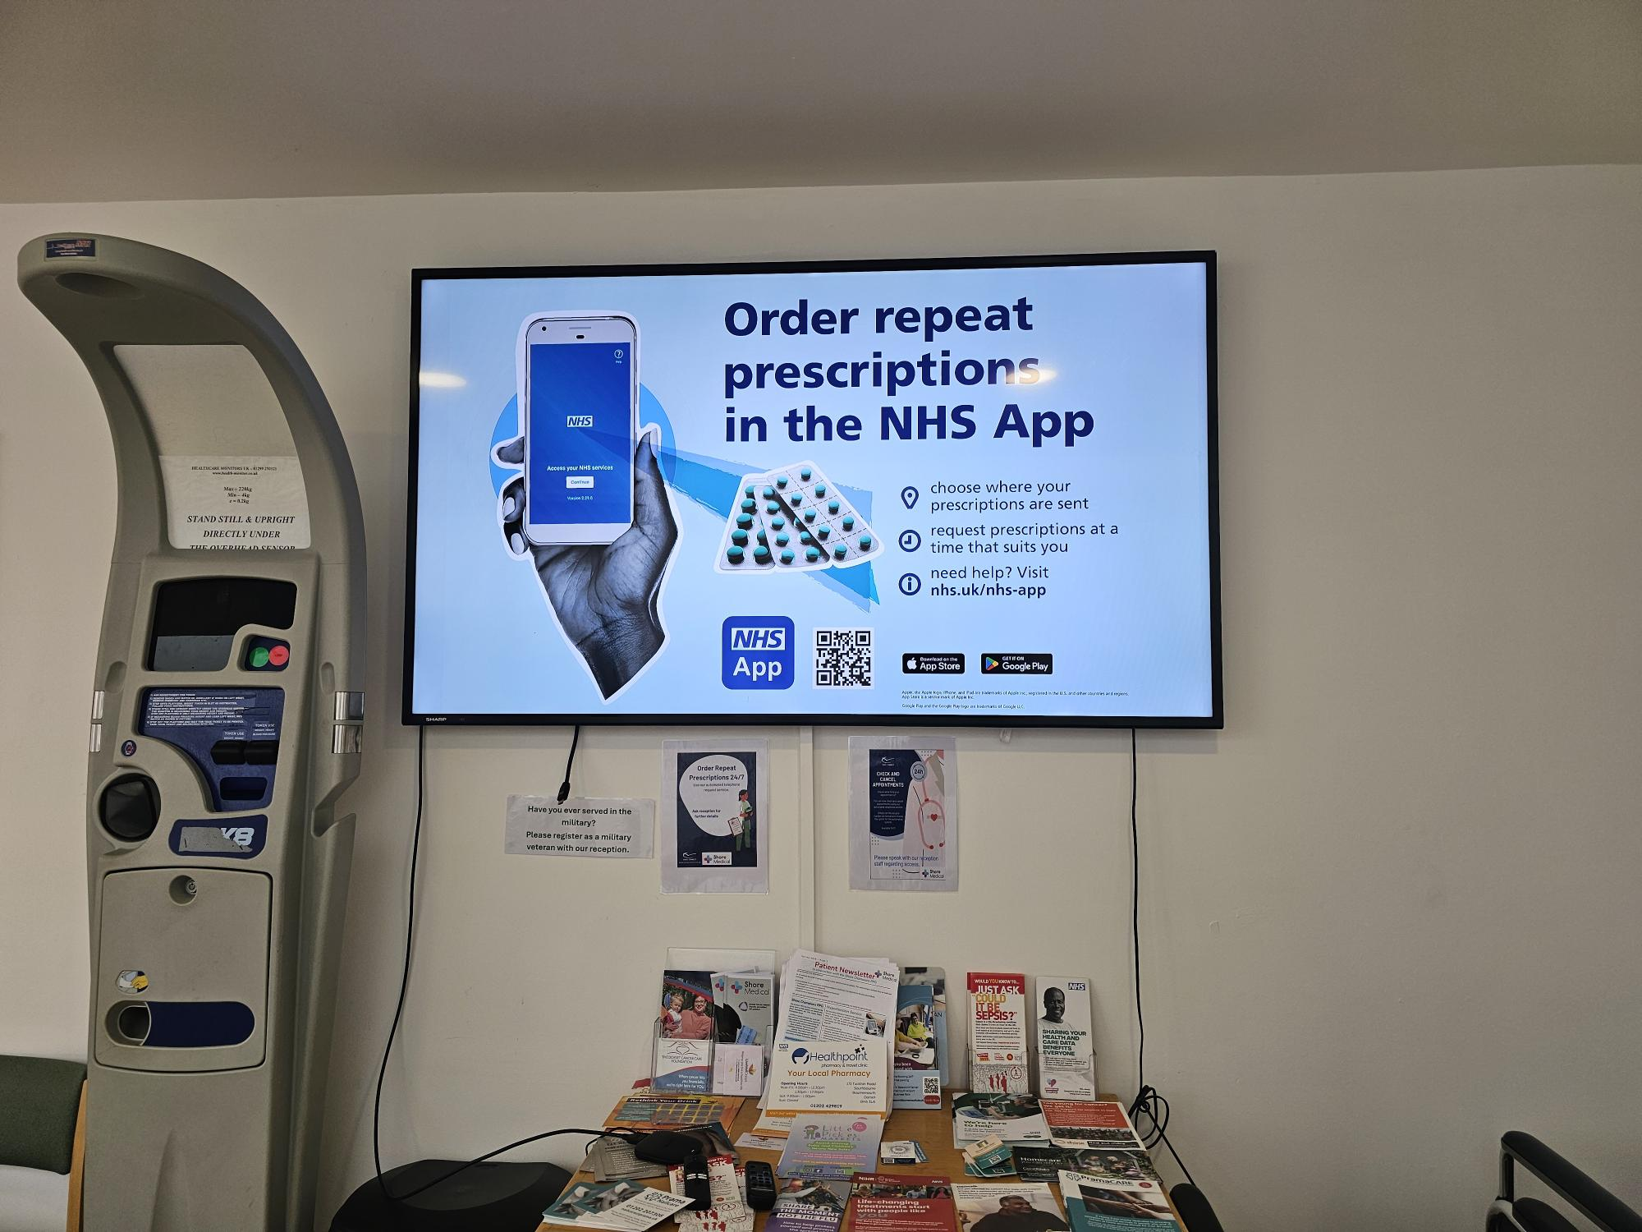
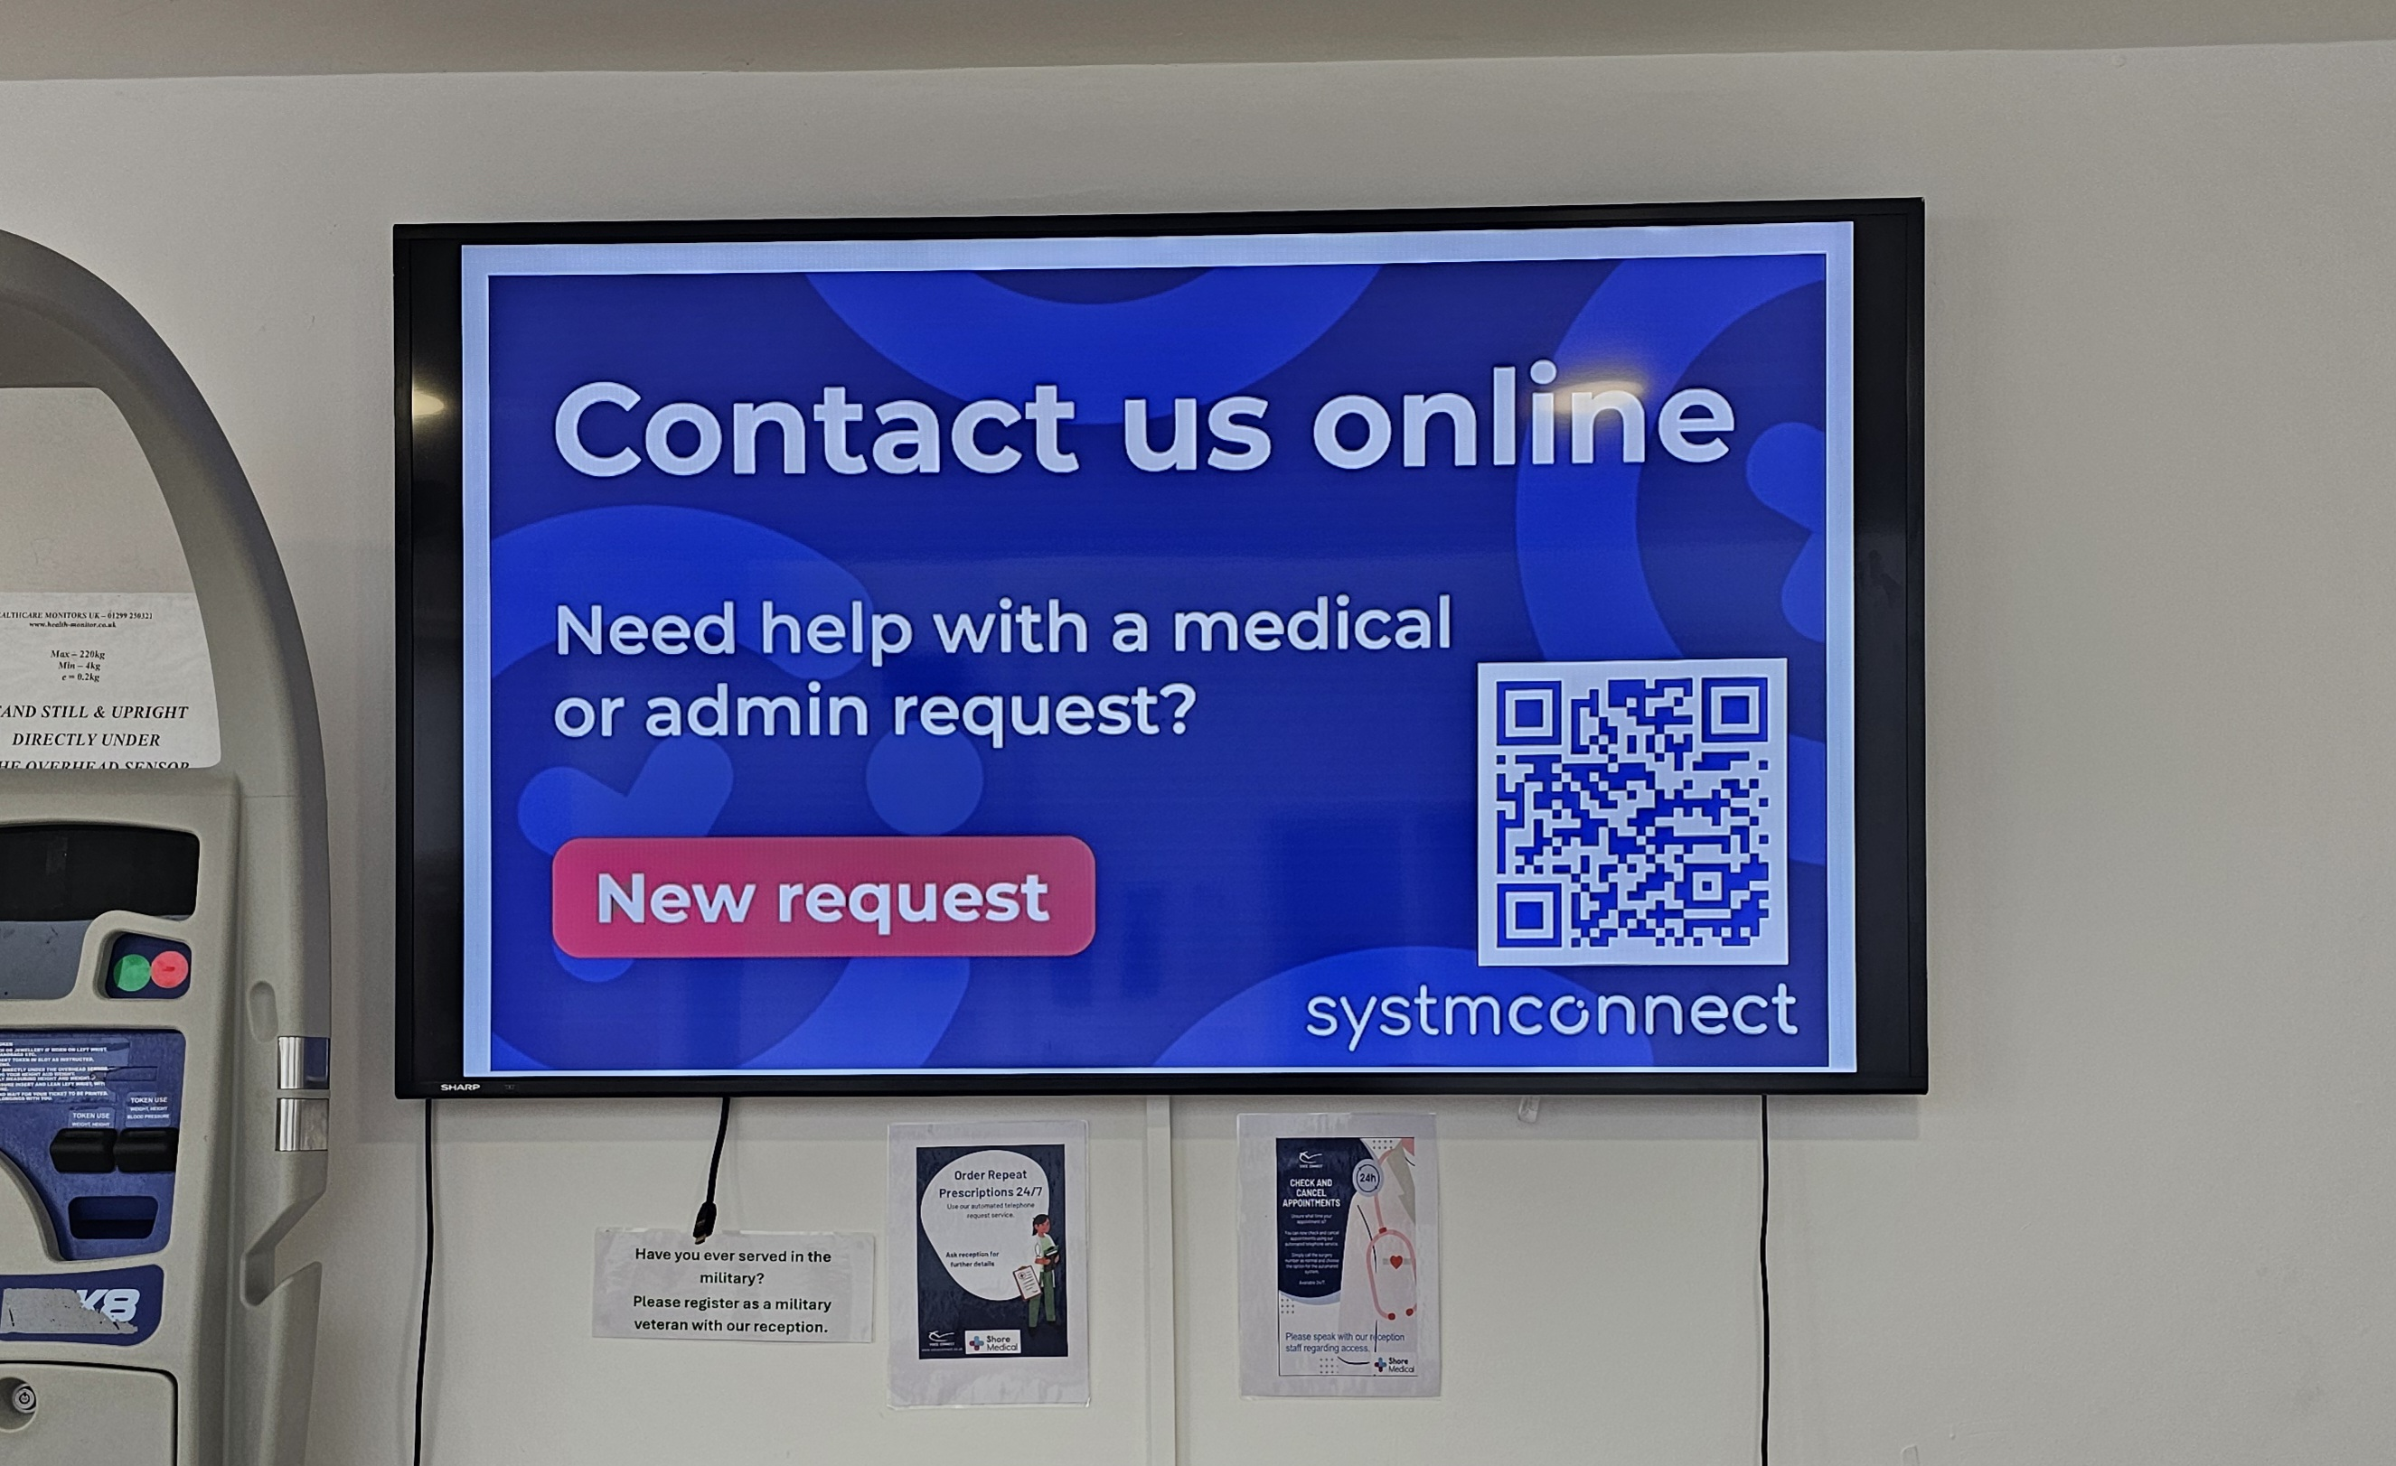
Digital Display on TV

Slide 11
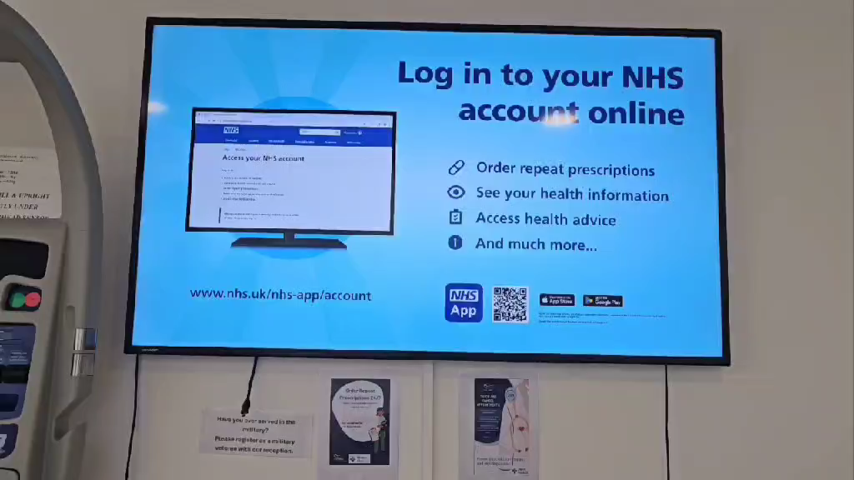
Digital Display on TV

Slide 12
Patient Partner
https://www.youtube.com/watch?v=VYZSRrL-plQ

Slide 13
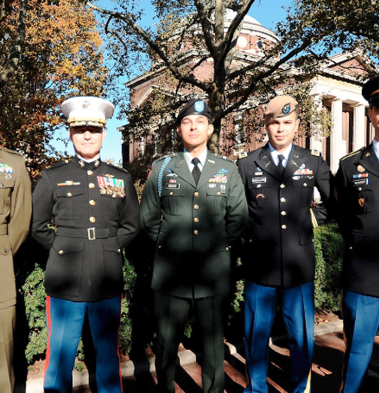
Veterans Coffee Mornings
On Wednesday, 1st October, we held our first coffee hour for military veterans at Fernside Surgery. There was a good turnout turn out and had a lovely group of people who attended.
The meeting began with introductions and listening to each other's stories, which was interesting and became a starting point for group discussion.
The coffee hour will run on the first Wednesday of the month
We would like to invite a PPG member(s) to the Veteran group coffee morning to promote the PPG group but also share information about the coffee mornings and lunch Club run by the group. There next meeting will be on the 5th November.
This Photo by Unknown Author is licensed under CC BY

Slide 14
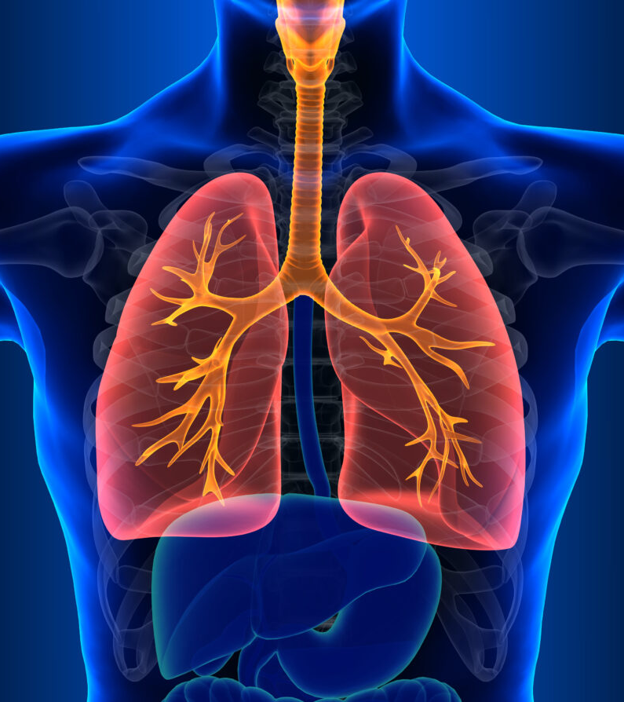
Respiratory Hub
At the Last PPG Meeting We spoke about launching a new Community Respiratory Hub based at St Mary’s Hospital in Poole to provide respiratory diagnostics closer to home for our patients.
This service aims to improve access and reduce waiting times by delivering high-quality respiratory assessments and diagnostics within a community setting, ensuring timely and convenient care for those with respiratory conditions.
This will go live next week so long as supplies are received.

Slide 15

British Heart Foundation Pilot
Shore Medical PCN are proud to be selected to be one of 3 PCN in Dorset to pilot a new program with University Hospital Dorset (Poole). It is a British Heart Foundation (BHF) research program that is looking to improve the outcomes of patient who have had a heart attack or coronary intervention – such as stent, coronary bypass or angioplasty.
We are referring high risk patient into a Nurse-led Secondary Prevention Lipid Clinic, run by cardiology.
We are starting with the highest priority of patients who have very high cholesterol and especially “bad fat” level known as LDL despite max tolerated statin dose.
They will assess patients, promote health lifestyle and diet choices as well as consider additions of medical therapy. This may be additional oral medications or may be newer injectable lipid lowering medications such as Inclisiran.
This Photo by Unknown Author is licensed under CC BY-SA

Slide 16
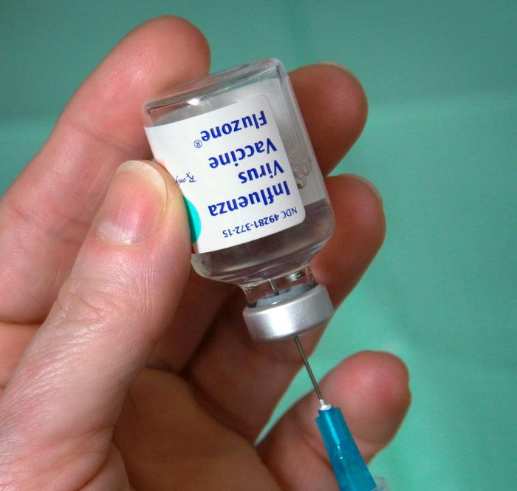
Autumn Flu
Season
Flu vaccination has started.
Between 1st October and 18th of October we will have administered
5500 flu jabs
600 care home staff
Last Saturday 1000 flu vaccines were given.
This Photo by Unknown Author is licensed under CC BY-SA-NC

Slide 17
Interim PPG Meeting
We planned for two interim meetings to take place where PPG members met independently of Shore Medical to plan Agendas and agree responsibilities within the group.
The meeting scheduled for 17th September was cancelled as only three members were available to attend.
We therefore need commitment from a core number of PPG members to attend going forward.
The group need to agree responsibilities such as :
  Updating the notice boards – advertising for roles
  Named coordinator to share information between meetings and with Anne including Gill’s Emails
  Acting as the patient voice put forward agenda items e.g. canvass patients by way of questionnaire as to what areas patients would like their PPG to focus on.
  PPG recruitment and volunteering
  Admin lead for WhatsApp, now that Phil has resigned.
  Items for the newsletters – could include link to short questionnaire for patients to tick in terms of focus areas.
Anne is happy to book the meeting room for an interim meeting, but attendance will need to be agreed in advance as the meeting room is in high demand.
Anne will continue to do the minutes of meetings as agreed.

